Slide 1
Introduction to E-Government
Exercise: 4
Subject : ANALYSING PROJECTS REGARDING INTEROPERABILITY
Group No. A6
Names : Sahil Ladola
Ravi Ramani
Jeel Katrodiya
Yash Nakrani

Slide 2
Agenda
Project Overview
Why Interoperability Matters for ViDA
Interoperability Needs (EIF 2.0 Framework)
Building Blocks & Standards
Governance & Maintenance
GEA Alignment Evaluation
Conclusion & Recommendations

Slide 3

Project Overview – ViDA (Cross-Border public service)
Description:
Modernizing the VAT system in the EU to accommodate new technologies, diminish fraud, and ease business regulatory burdens, especially in cross-border trade and the platform economy, is Europe's Commission’s initiative referred to as VAT in the Digital Age (ViDA).
Focus on real-time reporting, platform economy, and single EU VAT registration
Key Features :
Digital reporting requirements
Real-time transaction reporting
Standardized e-invoicing
https://taxation-customs.ec.europa.eu/taxation/vat/vat-digital-age-vida_en#:~:text=On%208%20December%202022%2C%20the,development%20of%20the%20platform%20economy

Slide 4
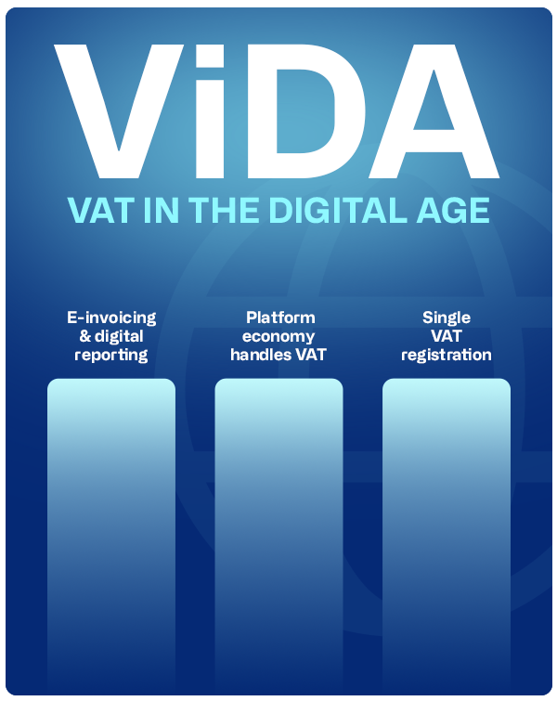
Relevance of Interoperability in ViDA
Why Interoperability Matters:
Enables seamless VAT reporting across 27 EU member states
Reduces administrative burden for multinational businesses
Ensures consistent data exchange between national tax authorities
Supports Digital Single Market objectives
Consequences Without Interoperability:
Fragmented reporting systems
Increased compliance costs for businesses
Inefficient fraud detection
https://www.continia.com/blog/vat-in-the-digital-age-vida-a-guide-for-businesses/

Slide 5
Interoperability Needs (EIF 2.0 Levels)
Legal Interoperability:
Harmonization of VAT rules across borders
Compliance with EU VAT Directive and new ViDA regulations
Organizational Interoperability:
Coordination between national tax administrations
Standardized business processes for VAT reporting
Semantic Interoperability:
Common data models for e-invoices and transaction reports
Shared understanding of VAT-related concepts
Technical Interoperability:
Secure data exchange protocols
API standards for system integration

Slide 6
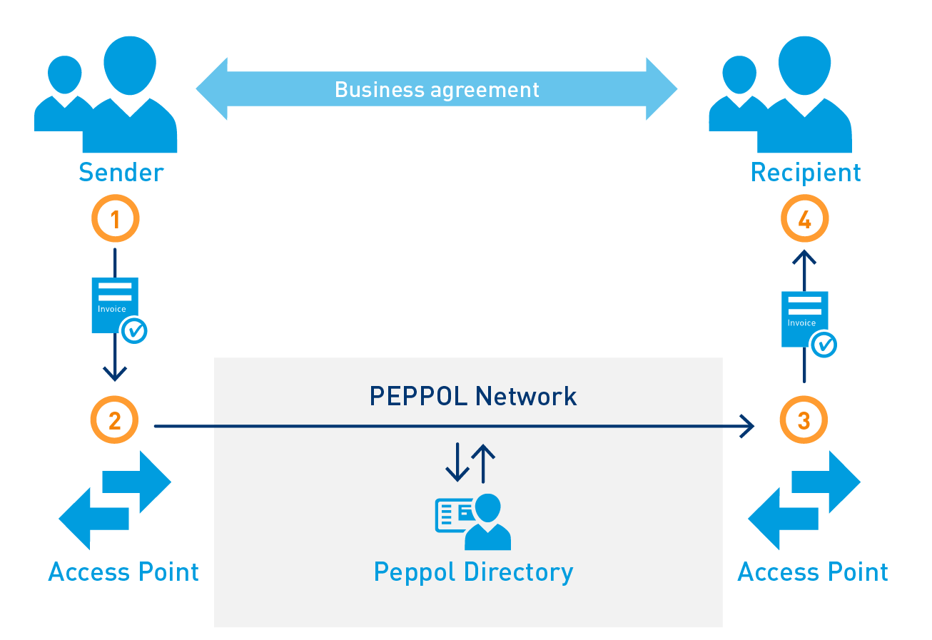
Building Blocks Used in ViDA
Technical:
PEPPOL network for e-invoicing
E-Delivery building blocks for secure data transfer
Semantic:
EN 16931 standard for e-invoicing
CEN/BII profiles for business documents
Organizational:
European Single Electronic Format (ESEF) for reporting
Legal:
EU VAT Directive as foundation
ViDA implementing regulations
https://images.app.goo.gl/SR8t6tMh75p4iouE6

Slide 7
Development and Maintenance of Building Blocks
EU Institutions:
DG TAXUD (Taxation and Customs Union) leads ViDA implementation
European Commission oversees standards development
Standardization Bodies:
CEN (European Committee for Standardization)
PEPPOL authority maintains e-invoicing specifications
National Authorities:
Each member state's tax authority implements local systems
Private Sector:
Software providers develop compliant solutions

Slide 8
Government Enterprise Architecture (GEA) Evaluation
Alignment with GEA Principles:
Service-oriented architecture approach
Reuse of existing EU digital building blocks (e.g., eID, eSignature)
Compliance with European Interoperability Reference Architecture (EIRA)
Evidence of GEA Application:
Clear separation of concerns (policy, business, technical layers)
Use of reference architectures for tax systems
Governance structure involving multiple stakeholders

Slide 9
Conclusion and Recommendations
Strengths:
Comprehensive approach covering all EIF levels
Building on proven EU digital infrastructure
Challenges:
Differing national implementations may create fragmentation
Need for ongoing coordination among member states
Recommendations:
Strengthen governance through Interoperable Europe Board
Expand use of interoperability regulatory sandboxes
Enhance monitoring through NIFO framework

Slide 10
Reference
European Interoperability Framework (EIF) 2.0
https://eur-lex.europa.eu/legal-content/EN/TXT/?uri=CELEX%253A52017SC0134
Interoperable Europe Act (2024/903)
https://eur-lex.europa.eu/eli/reg/2024/903/oj
https://interoperable-europe.ec.europa.eu/collection/nifo-national-interoperability-framework-observatory/eif-monitoring
CEN/BII standards
https://www.cencenelec.eu/

Slide 11
Thank you for your attention !!!
Group No. A6
Names : Sahil Ladola
Ravi Ramani
Jeel Katrodiya
Yash Nakrani

